Slide 1
Axin
2021

Slide 2
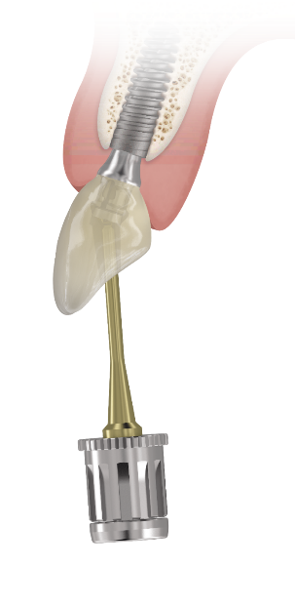
Summary
AxIN
What is AxIN?
Indications
Benefits
Components
AxIN provisional workflow
AxIN definitive workflow
Clinical case
Ancillaries for lab and practitioner
Take home message

Slide 3
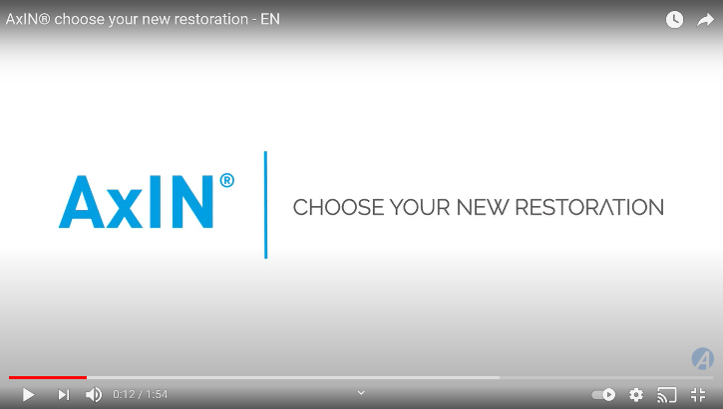
AxIN®
What is it ?
products
A customized SR tooth in zirconia with an ingenious Angulated Access performed in Simeda® CMC
Notes:
1 minute 50

Slide 4
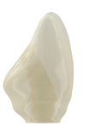
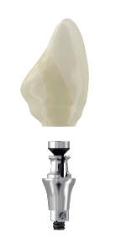
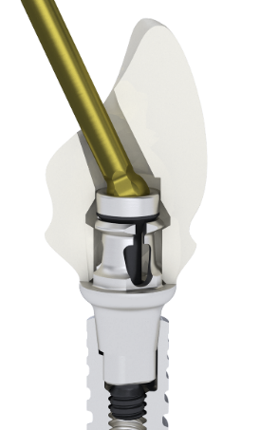
AxIN®
What is it ?
Crown in Zirconium milled by Simeda®
AxIN base + screw
Anthogyr spherical key
specific CAD CAM machining compartment
Notes:
The AxIN solution consists of a titanium base and a screw, where when the screw is tightened some wings open and block the crown made by CADCAM Simeda, which has a cavity with a specific machining compartment.

Slide 5
Summary
AxIN
What is AxIN?
Indications
Benefits
Components
AxIN provisional workflow
AxIN definitive workflow
Clinical case
Ancillaries for lab and practitioner
Take home message

Slide 6
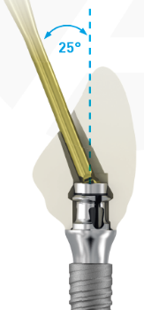
AxIN® Indications
For BL and TL, ALL sectors:
Anterior area : Aesthetic +++ and reduced maintenance
Pre-molar : Aesthetic + and reduced maintenance
Molar: Aesthetic and reduced maintenance Accessibility to screwing Available for Axiom BL Ø 4.0 / 5.0 Ht 2.5 and for Axiom TL ht neck 2.5 and 3.5 CONTRA-INDICATED in Ht 1.5 mm on Axiom BL and Axiom TL ➔ Anticipate the choice of implant and restoration before surgery
biologically safe
Single unit restorations

Slide 7
Summary
AxIN
What is AxIN?
Indications
Benefits
Components
AxIN provisional workflow
AxIN definitive workflow
Clinical case
Ancillaries for lab and practitioner
Take home message

Slide 8
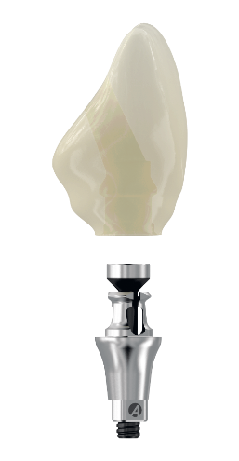
AxIN® Benefits
products
Biological safety
Promote screw-retained tooth
No sealing cement
Less risk of peri-implantitis
Mechanical assembly of the titanium base
No glue
Preservation of soft tissues
Titanium and zirconia material
Excellent biocompatibility

Slide 9
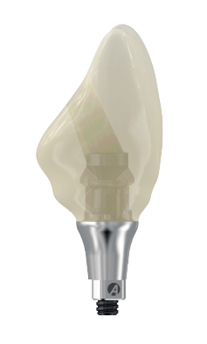
AxIN® Benefits
products
Ergonomic solution
Single-piece tooth
Built in screw
No handling of small screw in mouth
Angulated Access, free orientation between 0 and 25°
Oriented channels facilitate tightening the screws in the mouth
No implant indexation needed
Reduced and easy maintenance
Removable titanium base
Angulated Access, free orientation between 0 and 25°
Oriented channels to limit the risk of chipping
Easy handling for Dentist and Lab
Notes:
Easy handling : remodelling without oven?
Built in screw (visual) no loss or risk of error
In lab, handling is easier than a titanium base thanks to the lab base (regulated friction) false supple gingiva, buried prosthesis => « spring » effect => rises => difficult
Very easy : impression directly on implant, same material, spherical screwdriver, extractor (less equipment/material?)
Receive from prosthetist the finished tooth
Single position : (customized) indexation => whatever the trilobe’s position in the mouth
Peculiarity : the screw is already part of the base => no transport, simplicity, handling comfort, implemented/established?

Slide 10
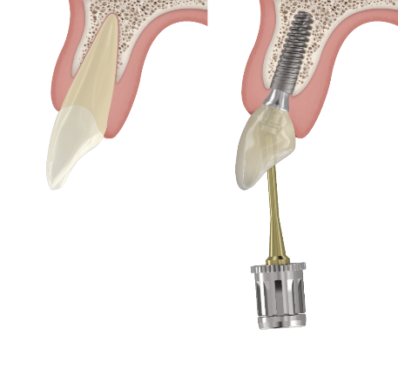
AxIN® Benefits
products
Closer to the natural tooth
Screw inserted through the bottom part
Narrow channel diameter
Preserved mechanical integrity
Ceramic support
Minimum height: 4.9mm
Minimum diameter: 4.5mm
AxIN®
Market standards
Notes:
Positioning of the implant in the root orientation.
No need of placing the apex on palatin side.

Slide 11
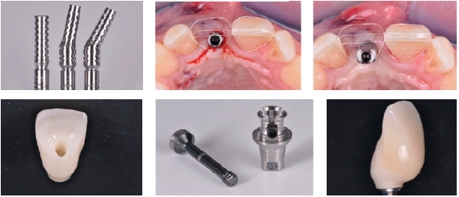
AxIN® Benefits
products
Aesthetic excellence
Angulated Access, free between 0 to 25°
Narrow screw channel (2.0 mm)
From provisional to definitive
Temporary angulated solution to pre-shape soft tissues
Notes:
ML, Z, T
Customized emergence profile
Haut de gamme, sur mesure Simeda, anatomique, précisions, logement spécifique
Zirconia tooth
(CAD CAM tooth)

Slide 12
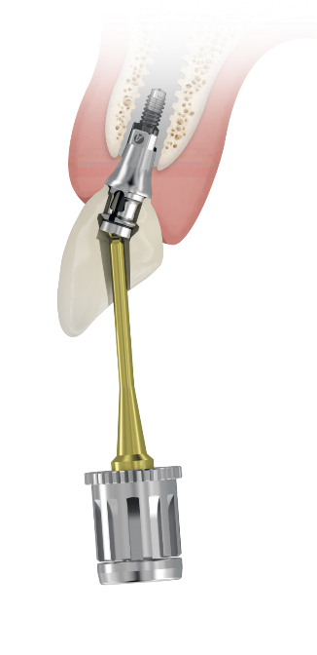
AxIN® Benefits
products
Aesthetic & efficient prosthetic innovation
Screw-retained anatomical tooth
Biological safety : no cement, no glue
Aesthetics : narrow channel Angulated Access
User friendly : integrated screw and Angulated Access
Choice of zirconia
For BL and TL, all sectors
Serenity® guarantee
Good to know* !
2/3 of cases are placed in posterior areas.
New vision
Closer to the natural tooth
Simplified treatment
Notes:
Accessibility to innovation
• Immediate loading solutions
with angled provisional components
INNOVATION january 2019
Zirconia Sina Z, T, ML

Slide 13
Summary
AxIN
What is AxIN?
Indications
Benefits
Components
AxIN provisional workflow
AxIN definitive workflow
Clinical case
Ancillaries for lab and practitioner
Take home message

Slide 14
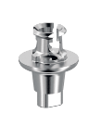
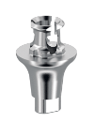
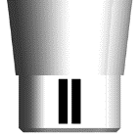
AxIN® Components
BL DEFINITIVE COMPONENTS
BASE Ø 4.0
Hg 1.5
Hg 2.5
BASE Ø 5.0
Ball wrench key
Abutment Extractor
Hg 1.5
Hg 2.5
Definitive M1.6 screw
Height identification on base and screw
Monogram on three lobed
Identification with lines for each height
Ht 1.5 : contra-indicated in molar sector

Slide 15
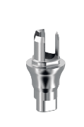
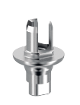
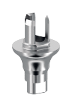
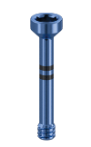
AxIN® Components
BL LAB COMPONENTS
Lab base
Axiom BL Ø 4.0
Delivered with engaged screw
AxIN® manipulation key For axiom® Multi Level®
Hg 1.5
Hg 2.5
Lab base
Axiom BL Ø 5.0
Delivered with engaged screw
Very light screwing
< 5 N.cm
Ball wrench key
M1.6 BL AA lab screw
Anodized blue
1 per gingival Ht
Hg Identification
Height identification on base and screw

Slide 16
AxIN® Components
TL DEFINITIVE COMPONENTS
TL BASE
TL N
TL R
Ball wrench key
Definitive M1.6 screw
Common R/N
Bicolor black/titanium
Monogram on three lobed
Contra-indicated in molar sector on Axiom TL implant N and R 1.5 ht neck

Slide 17
AxIN® Components
TL LAB COMPONENTS
AxIN® manipulation key For axiom® Multi Level®
TL lab base
Delivered with engaged screw
TL N
TL R
Very light screwing
< 5 N.cm
Ball wrench key
M1.6 BL AA lab screw
Anodized blue
Common R/N

Slide 18
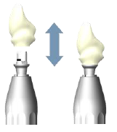
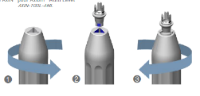
AxIN® Components
AxIN® manipulation key for axiom® Multi Level®
Out of mouth use : for lab and practitioner
Disassemble the crown from the final base.
Optional: easily assemble the crown on the definitive base..
AxIN BL/TL base is held at the level of the BL/TL tri-lobe.

Slide 19
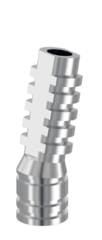
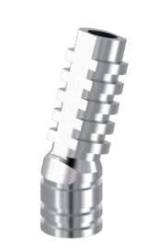
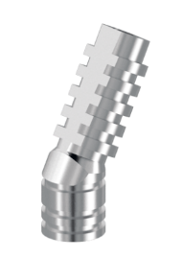
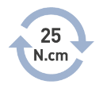
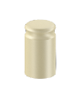
AxIN® Components
PROVISIONNAL COMPONENTS
Temporary coping 10, 15 or 25°
Optional : protective cap Ø 4.0, 4.8, 5.0
Used at the dental office, to cover the base in mouth

Slide 20
Summary
AxIN
What is AxIN?
Indications
Benefits
Components
AxIN provisional workflow
AxIN definitive workflow
Clinical case
Ancillaries for lab and practitioner
Competitors
Take home message

Slide 21
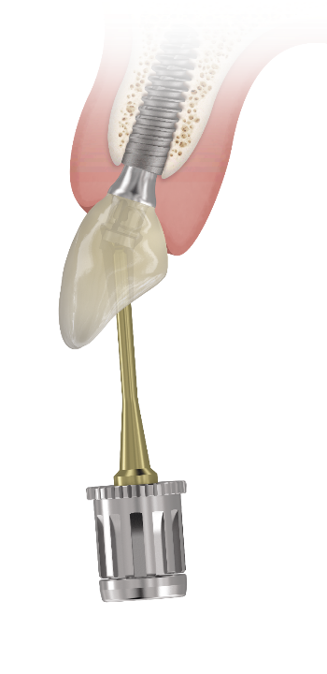
AxIN® Provisional workflow
Workflow temporary tooth
At the lab
At the practitioner’s office (2 possibilities)
Notes:
Ht mini = 4.4 con deflexión de tornillos + 0.5 espesor de prótesis arriba
Dia en la plataforma N o 4.0 = 4.3 a 0.5 mm para respetar el grosor mini - bajo exocad / DW / 3shape

Slide 22
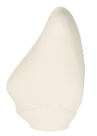
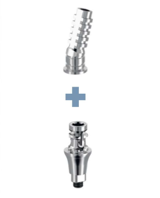
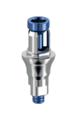
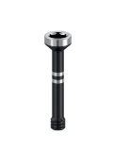
AxIN® Provisional workflow
AT THE LAB
Choice of the provisory abtmt
Ht, Ø, angulation
Making of the provisory on model
With a market tooth
Assembly of the provisory tooth
Send to the practitioner
Ti-base and its screw – 1 bag
Coping – 1 bag
Provisory coping +
Lab base
Ti-base with a three lobed indexation

Slide 23
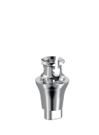
AxIN® Provisional workflow
AT THE PRACTITIONER’S OFFICE – 1st possibility - Made on definitive Ti-base
Choice of the provisory abtmt
Ht, Ø, angulation
Making of the provisory in and outside the mouth
With a market tooth
Assembly of the provisory tooth
Ti-base and its screw – 1 bag
Coping – 1 bag
Ti-base with a three lobed indexation
Provisory coping + Ti-base

Slide 24
AxIN® Provisional workflow
AT THE PRACTITIONER’S OFFICE – 2nd possibility – Made on lab base
Choice of the provisory abtmt
Ht, Ø, angulation
Making of the provisory outside the mouth
With a market tooth
Assembly of the provisory tooth
+ Protected gingiva
Optional :
Protective cap on base in mouth
Ti-base and its screw – 1 bag
Coping – 1 bag
Provisory coping + lab base
Ti-base with a three lobed indexation

Slide 25
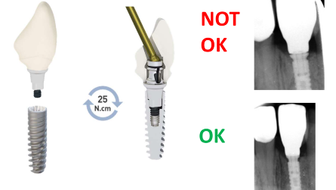
AxIN® Provisional workflow
AxIN – PROVISIONAL – Recommendations:
It is advised to disinfect the provisional before placing it in mouth.
index the implant correctly during the surgery
Do an x-ray to control
Close the screw shaft

Slide 26
Summary
AxIN
What is AxIN?
Indications
Benefits
Components
Manipulation
AxIN provisional workflow
AxIN definitive workflow
Clinical case
Ancillaries for lab and practitioner
Competitors
Take home message

Slide 27
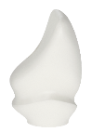
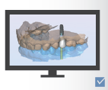
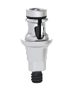
AxIN® Definitive workflow
LAB WORKFLOW
Assembling the crown in its correct position on the final base with its screw before sending it to the clinic
Reception of crown and final base, unassembled
Crown finishing on laboratory basis
CAD design (exocat, DW, 3shape)
or sent model / wax-up
web order*

Reminder: Before the 1st case:
download the new implant library with AxIN
Done by Mersch
Reco : delivered not mounted on the model
* AxIN contraindicated in Ht 1.5 in molar sector => choose base plate Ht 2.5, if case BL
Notes:
Deliver the finished AxIN tooth (e.g. in its Simeda box) not mounted on the model (otherwise it will be disassembled in 3 steps and reassembled by the dentist).

Slide 28
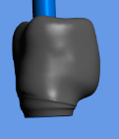
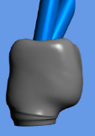
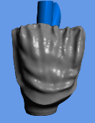
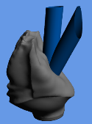
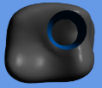
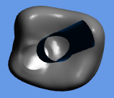
AxIN® Definitive workflow
Design options
Homothetical / Reduction and ordering of sina Z/T/ML/XT-T
Cut back » and ordering of sina ML
Homothetical
0°
15°
Cut back

Slide 29
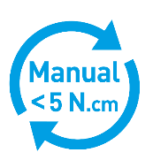
AxIN® Definitive workflow
Ceramisation of the crown
Lab Ti-base are mandatory - screwed at 5 N.cm
The crown platform must be clean of ceramic (glazure) to have a perfect fit on Ti-base, a correct deployment of the wings

Slide 30
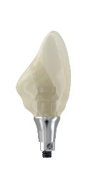
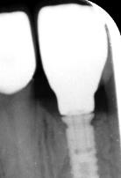
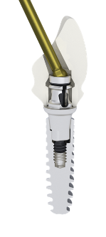
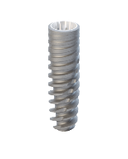
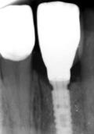
AxIN® Definitive workflow
PRACTITIONER WORKFLOW
Reception of the tooth
Placement on the implant
Screwing with ball wrench key
Check with an X ray
NOT
OK
OK

Slide 31
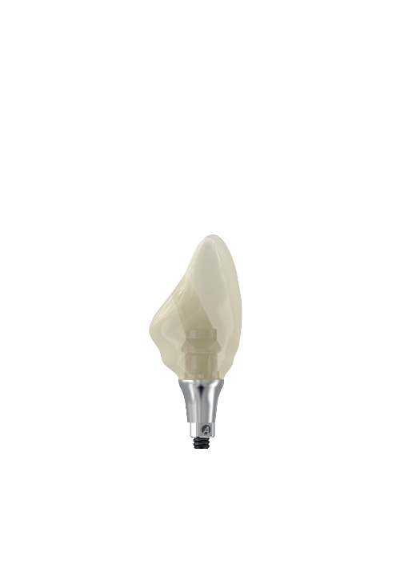
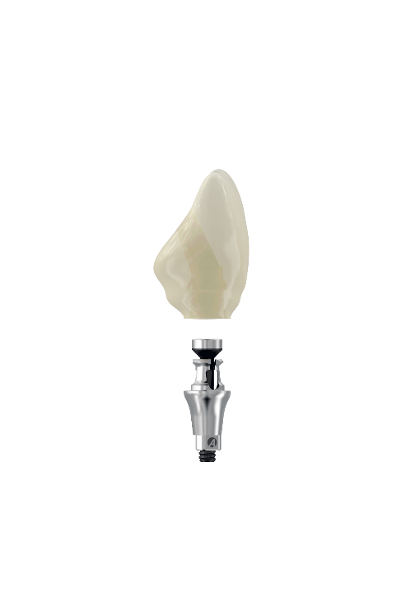
AxIN® Definitive workflow
AxIN – DEFINITIVE CROWN
Can be performed by laboratories with and without scanner
Angulated access up to 25º
Minimum height of the prosthesis above the base: 4.9 mm
Minimum diameter of the prosthesis 4.5 mm
1.5 height contra-indicated in the molar sector

Slide 32
Summary
AxIN
What is AxIN?
Indications
Benefits
Components
Manipulation
AxIN provisional workflow
AxIN definitive workflow
Clinical case
Ancillaries for lab and practitioner
Take home message

Slide 33
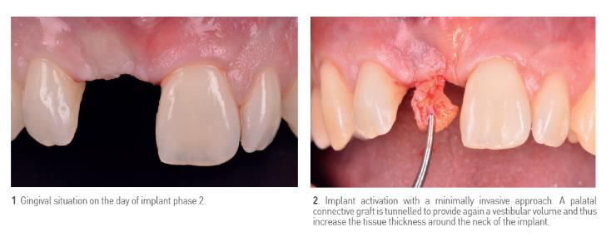
AxIN®clinical case
Case: Illustration of the gingival development and the preparation of a temporary screw retained prosthesis
Dr Margossian - TITANE – Revue Française Vol 16 / N° 3 / Sep 2019
Notes:
a 32-year-old patient, lost her central incisor in an accident. A bone reconstruction has been made with a GBR at the same time as the placement of the implant.

Slide 34
AxIN® clinical case

Slide 35
AxIN® clinical case

Slide 36
AxIN® Clinical Experience – EU Review
Notes:
Angulated Access, free between 0 to 25°
Narrow screw channel (2.0 mm)
Temporary angulated solution to pre-shape soft tissues : 10°, 15°, 25°
Conclusion : Continuous innovation in the field of implantology allowed the optimization of the results biological, aesthetic and functional. These latest developments
caused the obsolescence of cemented solutions.
Beyond a simple prosthetic evolution,it's a paradigm shift in positioning
anterior implant that is set up in the service of anatomy and biological

Slide 37
AxIN® Clinical Experience
Dr Margossian (Marseille – FR) : “Change of paradigm in anterior implant positioning” TITANE – French review Vol 16 / N° 3 / Sep 2019
With straight channel
With angulated channel
Illustration of the key differences in the design of two options of axis adjustment. The AxIN system on the left allows, among others, a preservation of material that ensures more room for layering in the vestibular area, and. better esthetic results
A : respects the anatomy, but channel in the free edge.
B : an ideal cingulate emergence, but apex of the implant close to the vestibular wall
C : apex of the implant close to the palatal wall.
Angulated Access allows an ideal positioning of the implant in the bone anatomy, while allowing an exit into the cingulum in order to preserve the vestibular aesthetics.

Slide 38
Summary
AxIN
What is AxIN?
Indications
Benefits
Components
AxIN provisional workflow
AxIN definitive workflow
Clinical case
Ancillaries for lab and practitioner
Take home message

Slide 39
AxIN® ancillaries
Instruments
LAB
PRACTITIONER’S OFFICE
AxIN lab kit or the AxIN key + lab base + ball wrench
« order on e.shop or on Anthogyr Simeda weborder “
equipped with the ball wrench ? + order the BL slimmed down extractor abutment (highly recommended) + AxIN key (advisable +++)
=> « order on e.shop ”

Slide 40
Summary
AxIN
What is AxIN?
Indications
Benefits
Components
AxIN provisional workflow
AxIN definitive workflow
Clinical case
Ancillaries for lab and practitioner
Take home message

Slide 41
AxIN®
TAKE HOME MESSAGE
A customized SR tooth in zirconia with an ingenious Angulated Access performed in Simeda® CMC
Closer to natural tooth
Biological safety : no cement, no glue
User friendly for the practitioner and the dental technician
BL & TL consistency, all sector (except Ht 1.5 in molar area)

Slide 42
Choose your new restoration

